Slide 1
Tarrant County 2021 Bond Election
Tarrant County Administrator’s Office

Slide 2
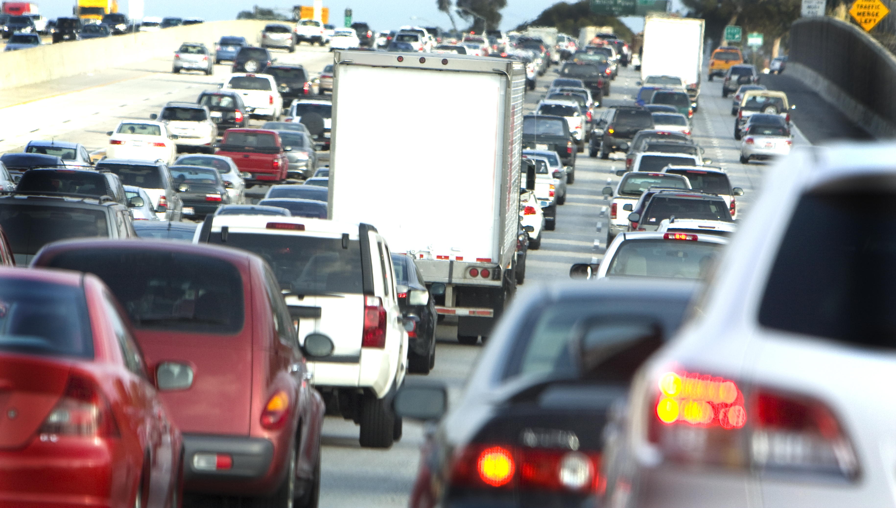
Proposition A:Traffic Mobility
Proposition A addresses the explosive growth in Tarrant County and the stress that it has placed on our local mobility infrastructure.
Prop A is proposed to improve traffic flow and reduce traffic congestion throughout the County.

Slide 3
Proposition A Bond Language
“The issuance of $400,000,000 of Tarrant County, Texas general obligation bonds for purchasing, constructing, reconstructing, renovating, rehabilitating, improving and maintaining streets, roads, highways and bridges within Tarrant County, including city, county and state streets, roads, highways and bridges, and the imposition of a tax sufficient to pay the principal of and interest on the bonds.”

Slide 4
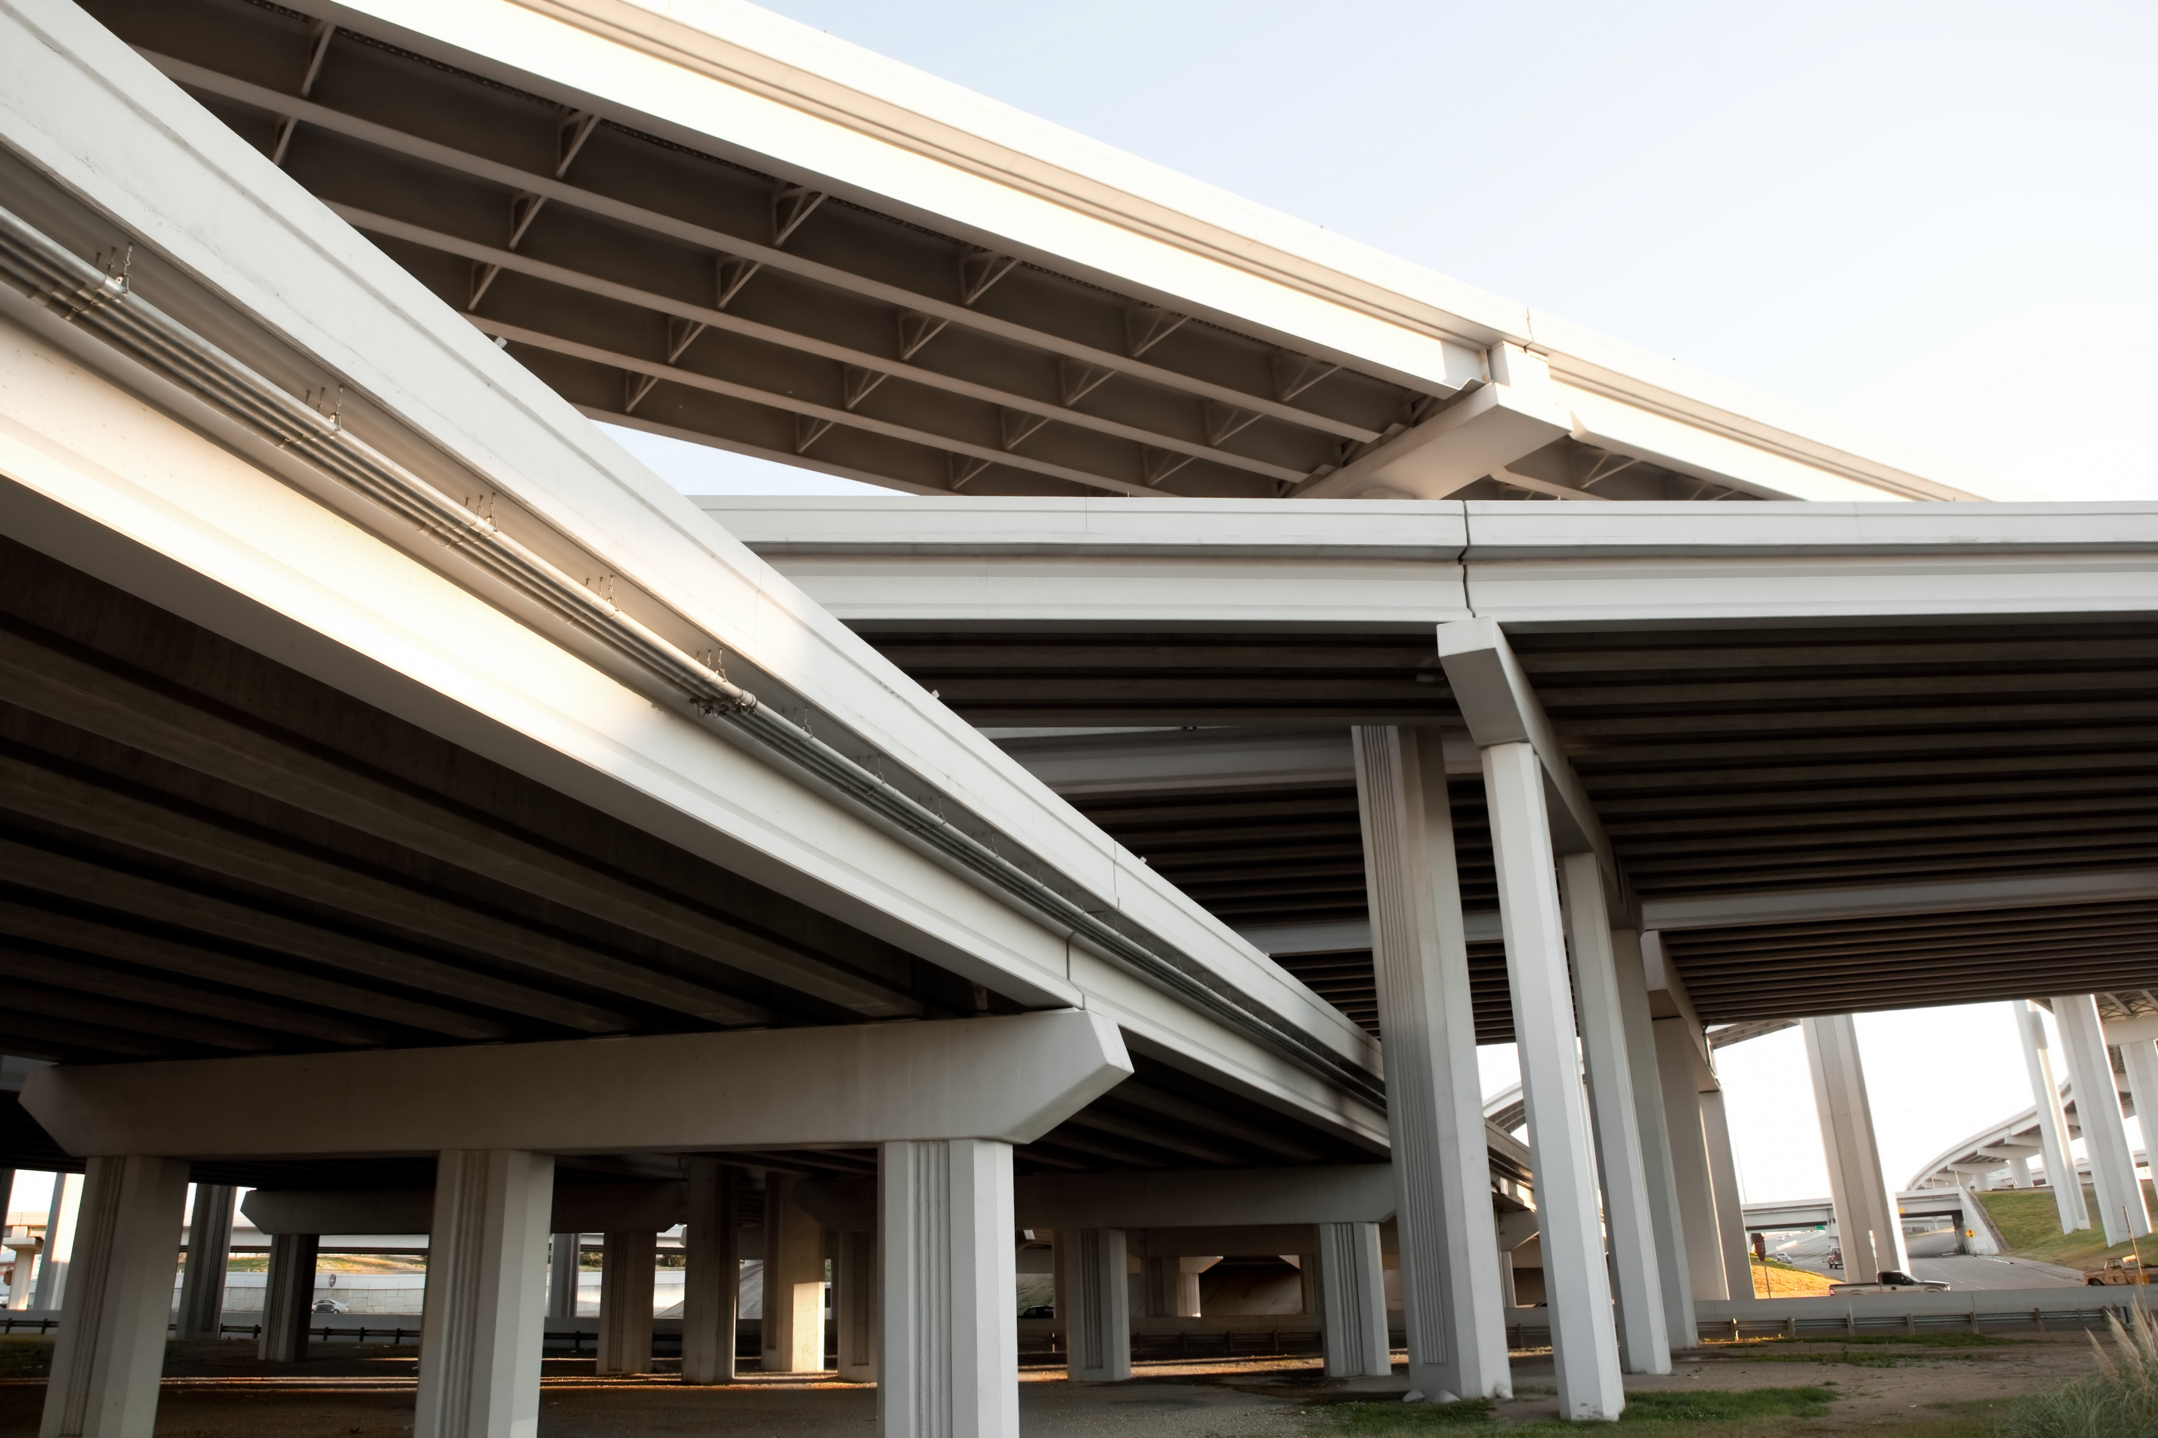
Proposition A Quick Facts
Tarrant County’s rapid population growth (97% since 1990) is likely to continue. If approved by voters, Prop A will address our local mobility infrastructure needs countywide to reduce traffic congestion.
Prop A addresses the need for new road projects countywide. A “Call for Road Projects” was issued to all municipalities across the County.
All cities who submitted projects for consideration received at least one project award.

Slide 5
Proposition A Quick Facts
The proposed bond package will bring an additional half billion dollars in local, state and federal matching road funding for needed projects throughout Tarrant County.
If approved by the voters, Prop A will not increase the County’s property tax rate.

Slide 6
Proposition B:Public Safety
Proposition B addresses the needs of the Tarrant County District Attorney’s Office to protect and serve the public as our population and case demand grows.
Prop B is proposed to expand and ensure state-of-the-art criminal prosecutorial efficiency.
"The mission of the office of Criminal District Attorney of Tarrant County is to enhance public safety through rigorous enforcement of criminal and civil laws in an ethical, honest and just manner; to encourage rehabilitation for deserving offenders; to earn the public’s trust by setting an example of transparency in our dealings; and to assist and educate victims of crimes and other members of the public."

Slide 7
Proposition B Bond Language
“The issuance of $116,000,000 of Tarrant County, Texas general obligation bonds for purchasing, constructing, improving and equipping a Criminal District Attorney office building to provide space for prosecutorial efforts and for other non-judicial county activities, and facilities in support thereof, and the purchase or improvement of sites therefor, and the imposition of a tax sufficient to pay the principal of and interest on the bonds.”

Slide 8
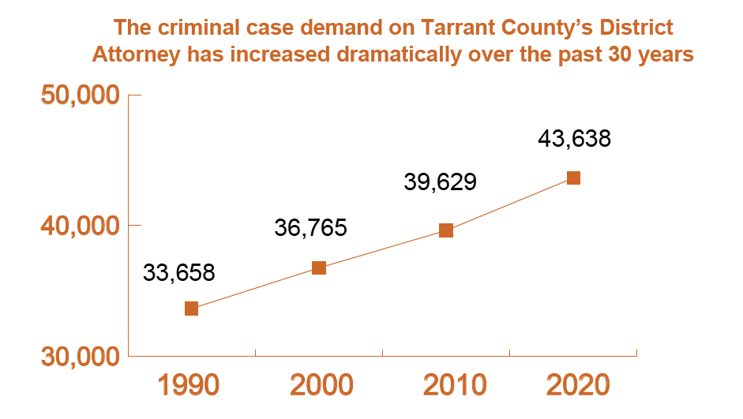
Proposition B Quick Facts
The Tarrant County District Attorney’s Office has outgrown the space it has occupied since 1990.
Since 1990, the DA’s Office has added several new prosecution units including those investigating Identity Theft, Gang Crimes, Victim’s Assistance, and Elderly Abuse.

Slide 9
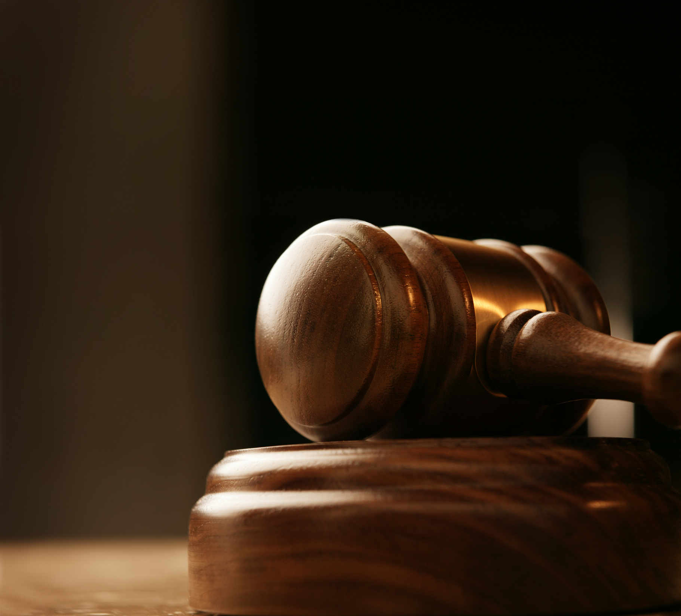
Proposition B Quick Facts
Along with Tarrant County’s growing population, criminal case filings and technology needs in the DA’s Office have increased dramatically since 1990.
If approved by the voters, Prop B will not increase the County’s property tax rate.

Slide 10
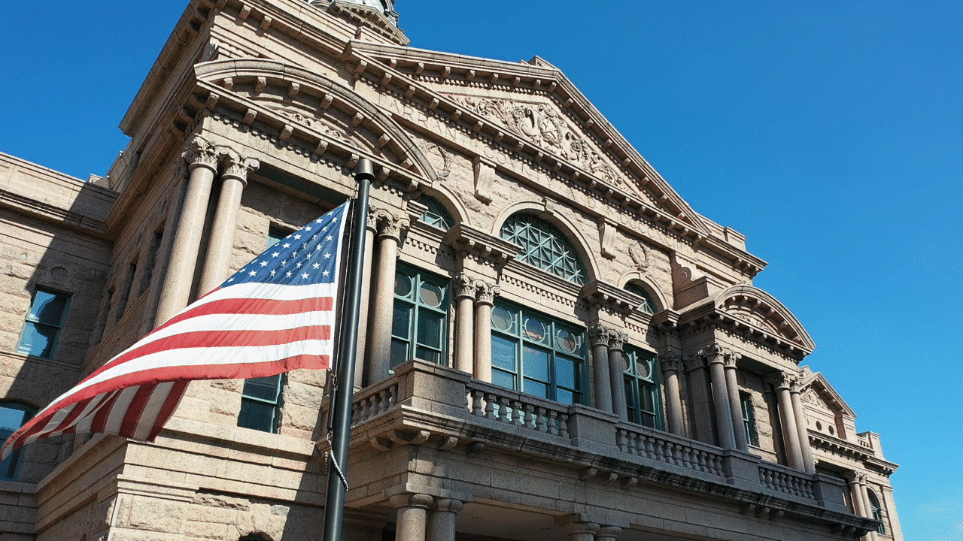
In-Person Early Voting: October 18-29, 2021
Election Day: Tuesday, November 2, 2021
for more information visit
www.tarrantcounty.com/bond2021

